Slide 1
GPU Implementation of Data-Aided Equalizers
Jeff Ravert
Advisor: Michael Rice

Slide 2
Outline
Introduction
Multipath
Equalizers
PAQ Project
Problem Statement
Equalizers
Static Multipath Testing
Conclusion

Slide 3
Introduction

Slide 4
Introduction - Multipath
Multipath interference is one of the dominant causes for link loss in aeronautical telemetry

Slide 5


Introduction - Multipath
Multipath interference is one of the dominant causes for link loss in aeronautical telemetry

Slide 6
Introduction - Multipath
Multipath interference is one of the dominant causes for link loss in aeronautical telemetry

Slide 7
Introduction - Multipath
Multipath interference is one of the dominant causes for link loss in aeronautical telemetry

Slide 8
Introduction - Multipath
Multipath interference is one of the dominant causes for link loss in aeronautical telemetry

Slide 9
Introduction - Multipath
Multipath interference is one of the dominant causes for link loss in aeronautical telemetry

Slide 10
Introduction - Multipath
Multipath interference is one of the dominant causes for link loss in aeronautical telemetry

Slide 11
Introduction - Equalizers
Blind equalizers
Adaptive filters
Use known statistical properties of the transmitted signal
Have no knowledge of the data or multipath channel
Data-aided equalizers
Filters calculated from the estimated propagation conditions
Use known data sequences of the transmitted signal
Estimate the multipath channel using the known data

Slide 12
Introduction - PAQ Project
The Preamble Assisted Equalization (PAQ) project compares the real-time bit error rate (BER) performance of
Blind equalizer (Quasonix)
No equalizer
Five data-aided equalizers
Zero-forcing (ZF)
Minimum Mean-square Error (MMSE)
MMSE-initialized Constant Modulus Algorithm (CMA)
Frequency Domain Equalizer One (FDE1)
Frequency Domain Equalizer Two (FDE2)

Slide 13
Introduction - PAQ Project
The Preamble Assisted Equalization (PAQ) project compares the real-time bit error rate (BER) performance of
Blind equalizer (Quasonix)
No equalizer
Five data-aided equalizers
Zero-forcing (ZF)
Minimum Mean-square Error (MMSE)
MMSE-initialized Constant Modulus Algorithm (CMA)
Frequency Domain Equalizer One (FDE1)
Frequency Domain Equalizer Two (FDE2)

Slide 14
Introduction - PAQ Project
T/M Receiver & Demod
T/M Receiver
ADC
Host CPU
Host CPU
FPGA
FPGA
BERT
K40c GPU
K20c GPU
K20c GPU
Rack Mounted Server
Rack Mount Case

Slide 15
Introduction - PAQ Project
T/M Receiver & Demod
RF
T/M Receiver
ADC
Host CPU
Host CPU
FPGA
FPGA
BERT
K40c GPU
K20c GPU
K20c GPU
Rack Mounted Server
Rack Mount Case

Slide 16
Introduction - PAQ Project
T/M Receiver & Demod
RF
70 MHz IF
T/M Receiver
ADC
Host CPU
Host CPU
FPGA
FPGA
BERT
K40c GPU
K20c GPU
K20c GPU
Rack Mounted Server
Rack Mount Case

Slide 17
Introduction - PAQ Project
T/M Receiver & Demod
RF
70 MHz IF
Samples
T/M Receiver
ADC
Host CPU
Host CPU
FPGA
FPGA
BERT
K40c GPU
K20c GPU
K20c GPU
Rack Mounted Server
Rack Mount Case

Slide 18
Introduction - PAQ Project
T/M Receiver & Demod
RF
70 MHz IF
Samples
T/M Receiver
ADC
Host CPU
Host CPU
FPGA
FPGA
BERT
K40c GPU
K20c GPU
K20c GPU
1.907 Seconds
of Samples
Rack Mounted Server
Rack Mount Case

Slide 19
Introduction - PAQ Project
T/M Receiver & Demod
RF
70 MHz IF
Samples
5 Bit Streams
T/M Receiver
ADC
Host CPU
Host CPU
FPGA
FPGA
BERT
K40c GPU
K20c GPU
K20c GPU
1.907 Seconds
of Samples
Rack Mounted Server
Rack Mount Case

Slide 20
Introduction - PAQ Project
T/M Receiver & Demod
No Equalizer
Bits
RF
70 MHz IF
Samples
5 Bit Streams
T/M Receiver
ADC
Host CPU
Host CPU
FPGA
FPGA
BERT
K40c GPU
K20c GPU
K20c GPU
1.907 Seconds
of Samples
Rack Mounted Server
Rack Mount Case

Slide 21
Introduction - PAQ Project
T/M Receiver & Demod
No Equalizer
Bits
5 Bit Streams
Blind Equalizer
Bits
RF
70 MHz IF
Samples
T/M Receiver
ADC
Host CPU
Host CPU
FPGA
FPGA
BERT
K40c GPU
K20c GPU
K20c GPU
1.907 Seconds
of Samples
Rack Mounted Server
Rack Mount Case

Slide 22
Introduction - PAQ Project
T/M Receiver & Demod
No Equalizer
Bits
5 Bit Streams
Blind Equalizer
Bits
RF
70 MHz IF
Samples
T/M Receiver
ADC
Host CPU
Host CPU
FPGA
FPGA
BERT
Data-aided
Equalizer Bits
K40c GPU
K20c GPU
K20c GPU
1.907 Seconds
of Samples
Rack Mounted Server
Rack Mount Case

Slide 23
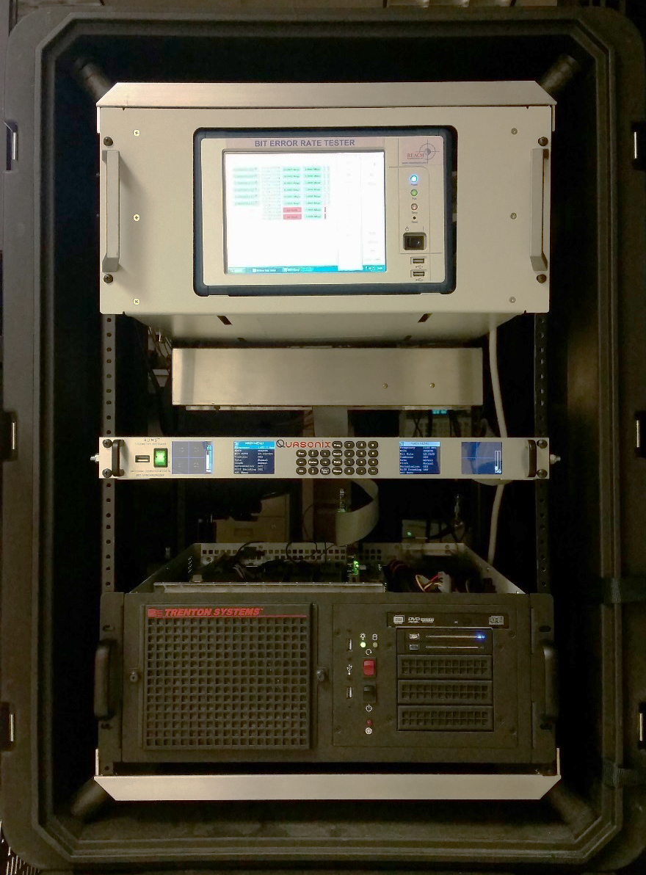
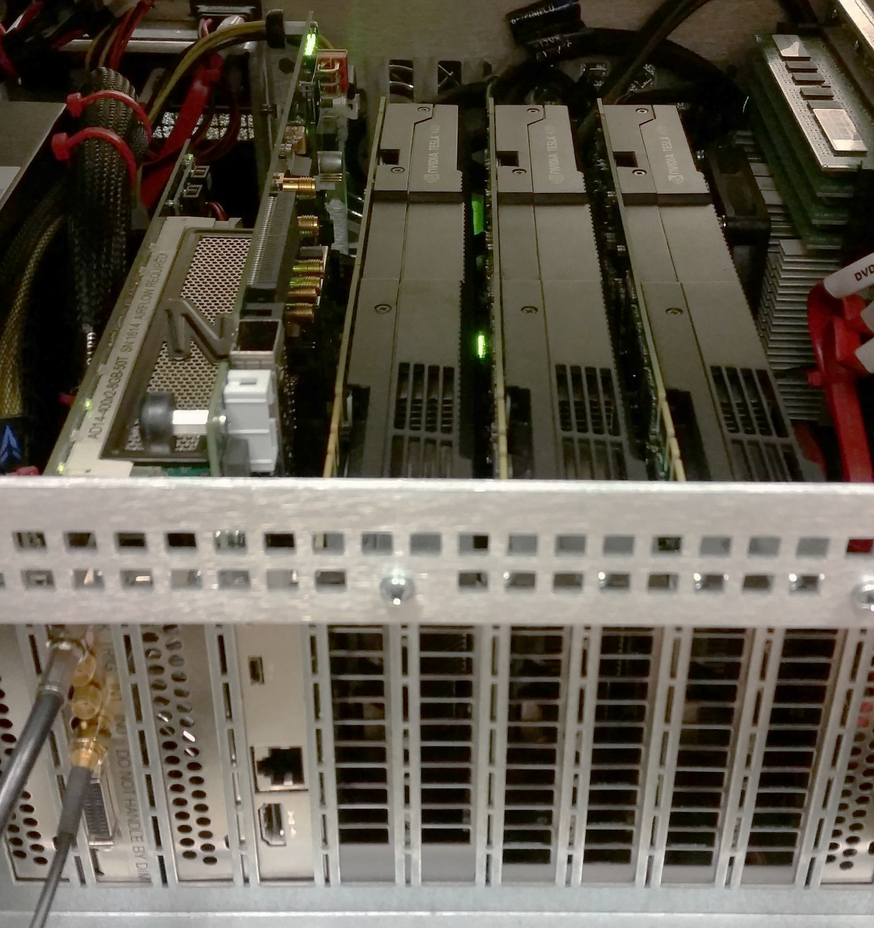
Introduction - PAQ Project
Host
CPU
BERT
T/M Receiver
Rack Mounted
Server
Rack Mount
Case
ADC
FPGA
K40c
GPU
K20c
GPU
K20c
GPU

Slide 24
Introduction - PAQ Project
To enable data-aided equalization, the known Preamble and Asynchronous Marker (ASM) data sequences are used to estimate:
Frequency offset
Channel impulse response
Noise variance
Phase offset
128 bits
64 bits
6144 bits
Preamble
ASM
Data
12672 samples at 2 samples/bit
Data
Preamble
ASM
Data
Preamble
ASM
Data

Slide 25

Introduction - PAQ Project
To enable data-aided equalization, the known Preamble and Asynchronous Marker (ASM) data sequences are used to estimate:
Frequency offset
Channel impulse response
Noise variance
Phase offset
128 bits
64 bits
6144 bits
Preamble
ASM
Data
12672 samples at 2 samples/bit
Data
Preamble
ASM
Data
Preamble
ASM
Data

Slide 26
Introduction - PAQ Project
To enable data-aided equalization, the known Preamble and Asynchronous Marker (ASM) data sequences are used to estimate:
Frequency offset
Channel impulse response
Noise variance
Phase offset
128 bits
64 bits
6144 bits
Preamble
ASM
Data
12672 samples at 2 samples/bit
Data
Preamble
ASM
Data
Preamble
ASM
Data
1.907 Seconds of Samples is 3103 or 3104 iNET packets

Slide 27
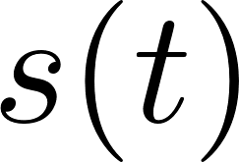

Introduction - PAQ Project
Transmitter
Transmitted
Signal
iNET
Packet
SOQPSK-TG
Modulator
Data Bits

Slide 28
Introduction - PAQ Project
Transmitter
Transmitted
Signal
iNET
Packet
SOQPSK-TG
Modulator
PN11
Sequence
Data Bits

Slide 29
Introduction - PAQ Project
Transmitter
Transmitted
Signal
iNET
Packet
SOQPSK-TG
Modulator
PN11
Sequence
Data Bits
128 bits
64 bits
6144 bits
Preamble
ASM
Data
6336 bits
Data
Preamble
ASM
Data
Preamble
ASM
Data

Slide 30
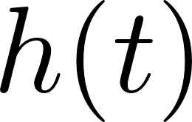
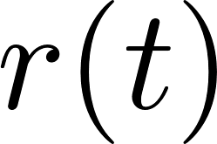

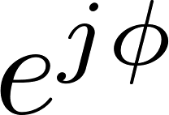

Introduction - PAQ Project
Transmitter
Transmitted
Signal
Distortions
iNET
Packet
SOQPSK-TG
Modulator
Channel
PN11
Sequence
Data Bits
128 bits
64 bits
6144 bits
Preamble
ASM
Data
6336 bits
Data
Preamble
ASM
Data
Preamble
ASM
Data

Slide 31
Introduction - PAQ Project
Transmitter
Transmitted
Signal
Distortions
iNET
Packet
SOQPSK-TG
Modulator
Channel
PN11
Sequence
Data Bits
RF
Down-Convert &
Filter
IF
Received Signal
Receiver
128 bits
64 bits
6144 bits
Preamble
ASM
Data
6336 bits
Data
Preamble
ASM
Data
Preamble
ASM
Data

Slide 32
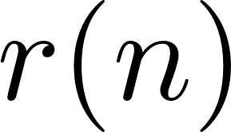
Introduction - PAQ Project
Transmitter
Transmitted
Signal
Distortions
iNET
Packet
SOQPSK-TG
Modulator
Channel
PN11
Sequence
Data Bits
RF
Down-Convert &
Filter
Resample
IF
ADC
Received Signal
Receiver
Server
128 bits
64 bits
6144 bits
Preamble
ASM
Data
6336 bits
Data
Preamble
ASM
Data
Preamble
ASM
Data

Slide 33




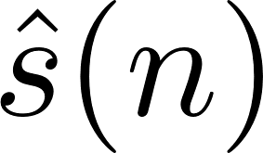
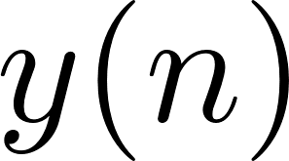
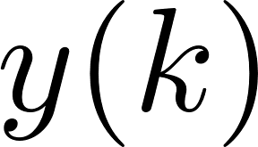
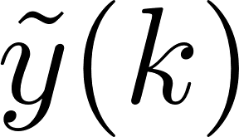




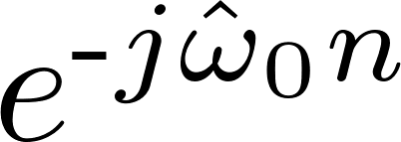
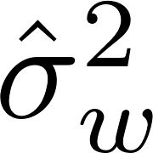
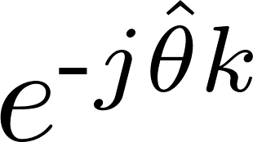
Introduction - PAQ Project
Preamble
Detector
Equalize
Detection
Filter
2
Frequency
Offset
Estimator
PLL
Estimators

Slide 34
Introduction - PAQ Project
Preamble
Detector
Equalize
Detection
Filter
2
Frequency
Offset
Estimator
PLL
Estimators
1.907 Seconds is 3103 or 3104 iNET Packets

Slide 35
Introduction - PAQ Project
Preamble
Detector
Equalize
Detection
Filter
2
Frequency
Offset
Estimator
PLL
Estimators
1.907 Seconds is 3103 or 3104 iNET Packets

Slide 36










Introduction - PAQ Project
Compute ZF
Filter
Apply Filters
OQPSK
Detector
Compute MMSE
Filter
Apply Filters
OQPSK
Detector
Compute CMA
Filter
Apply Filters
OQPSK
Detector
Compute FDE1
Apply Filters
OQPSK
Detector
Compute FDE2
Apply Filters
OQPSK
Detector

Slide 37
Problem Statement

Slide 38
Problem Statement
Compute ZF
Filter
Apply Filters
OQPSK
Detector
Compute each equalizer
Apply the detection filter and equalizer filters to the received signal
Meet the real-time constraint
Compute MMSE
Filter
Apply Filters
OQPSK
Detector
Compute CMA
Filter
Apply Filters
OQPSK
Detector
Compute FDE1
Apply Filters
OQPSK
Detector
Compute FDE2
Apply Filters
OQPSK
Detector

Slide 39
Zero-forcing (ZF) and
Minimum Mean-squared
Error (MMSE)
Equalizers

Slide 40
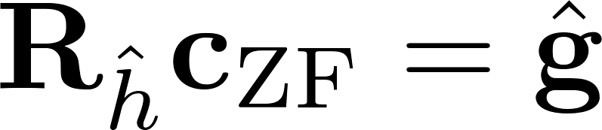
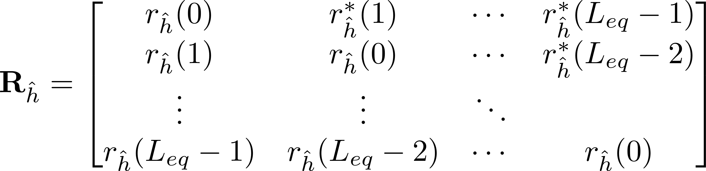
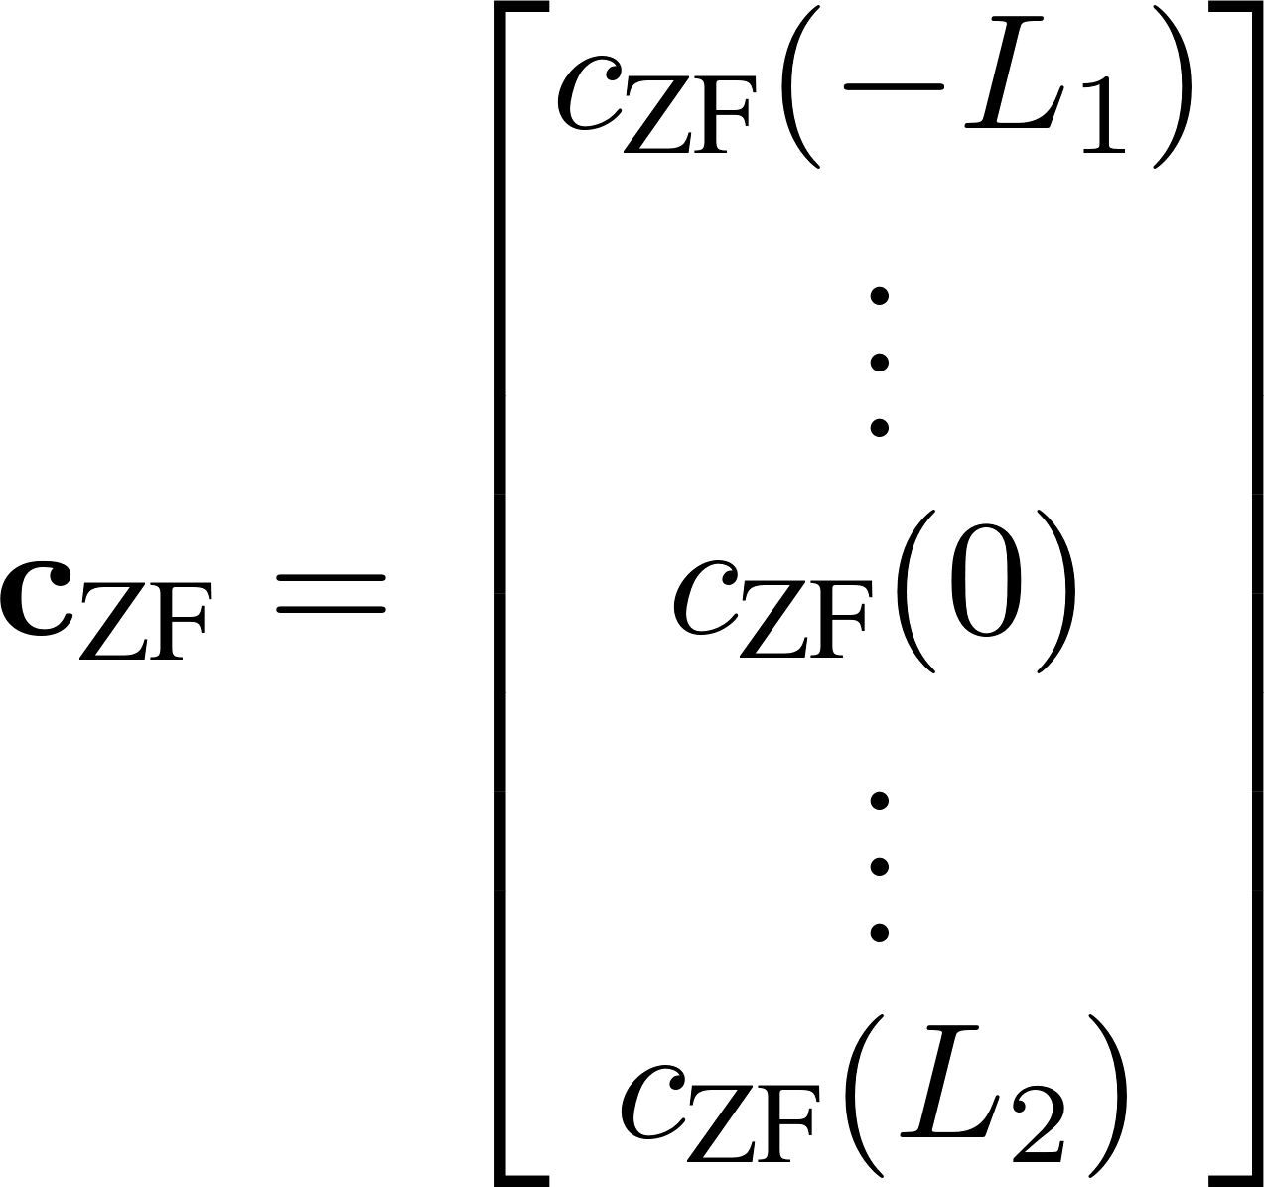
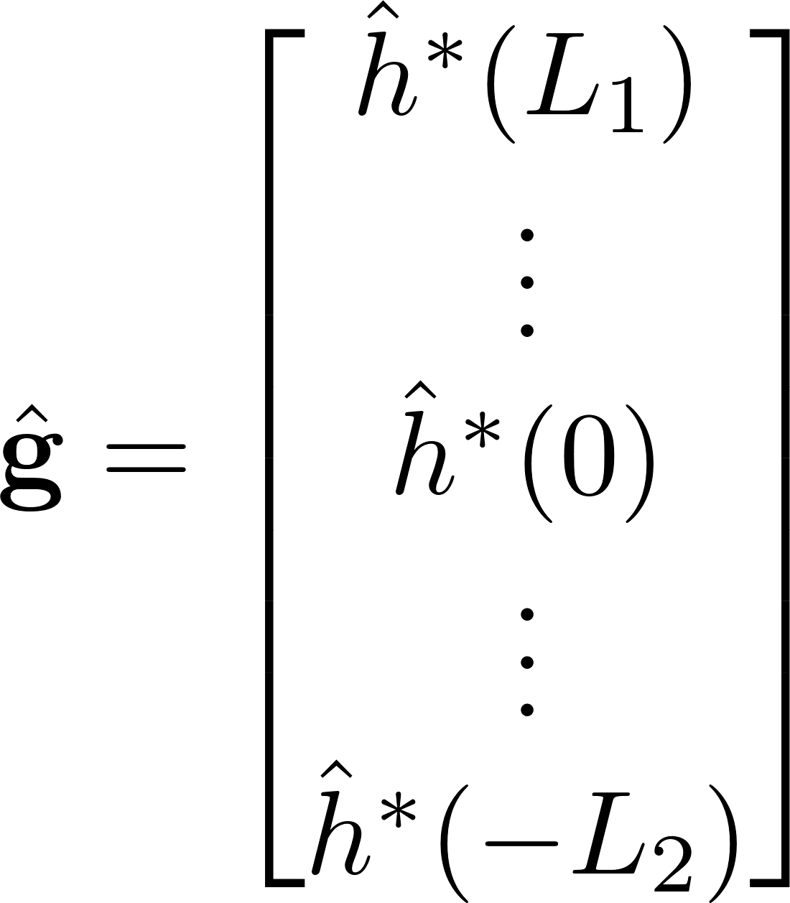
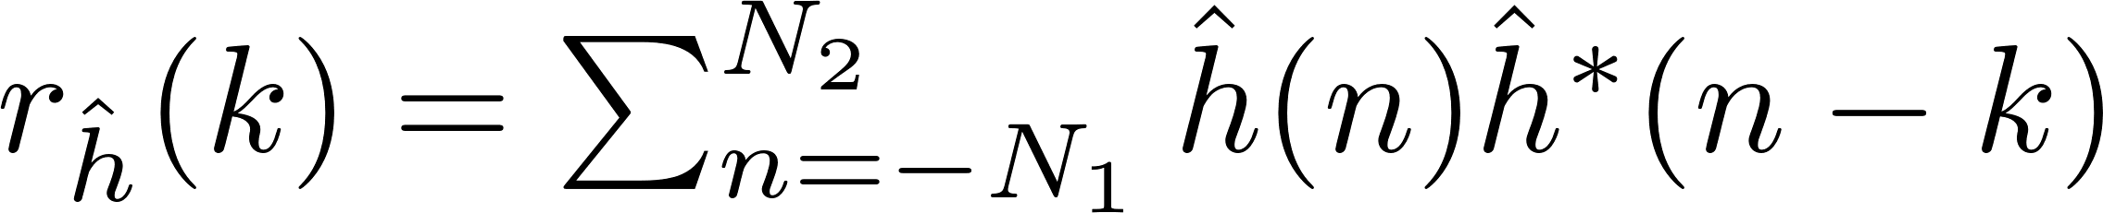
ZF Equations

Slide 41

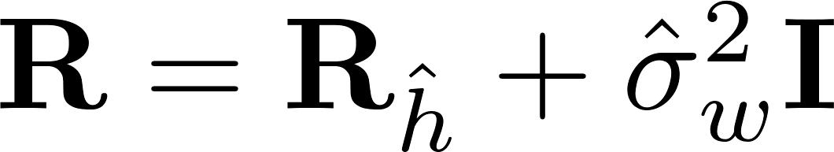
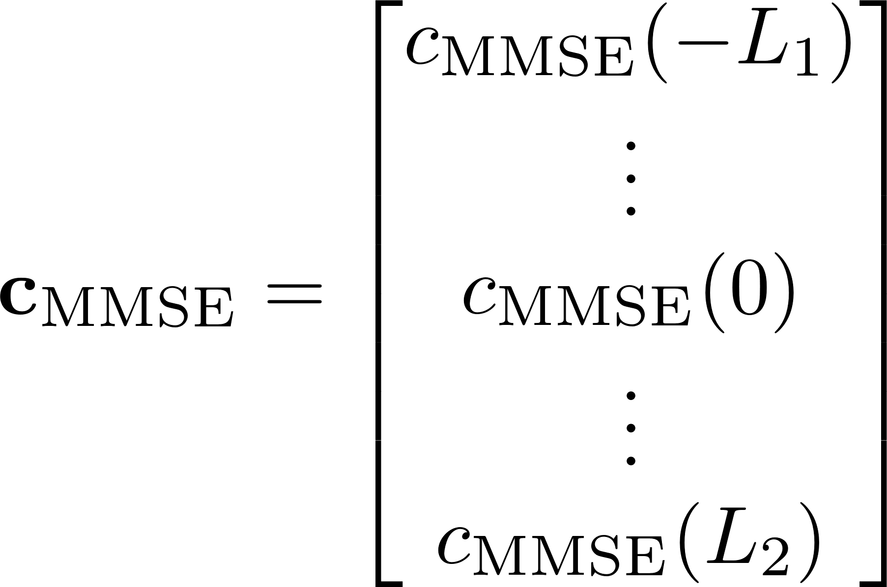
MMSE Equations

Slide 42
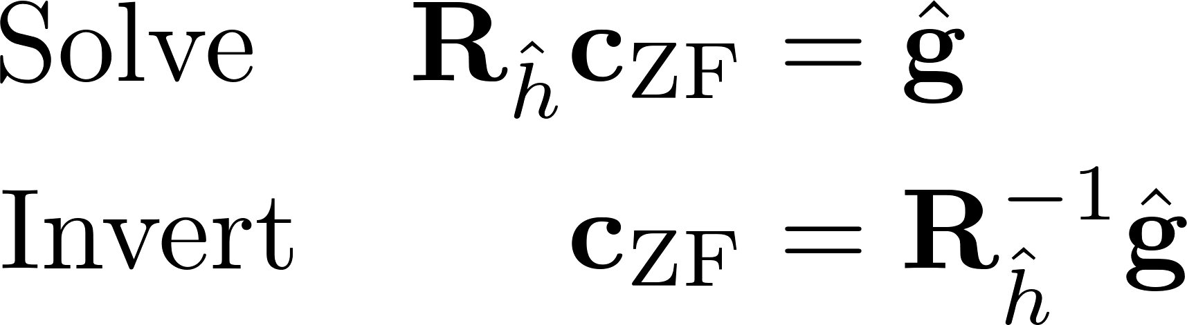
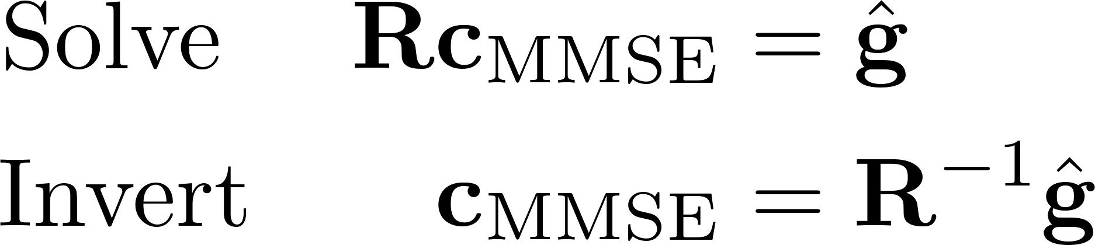
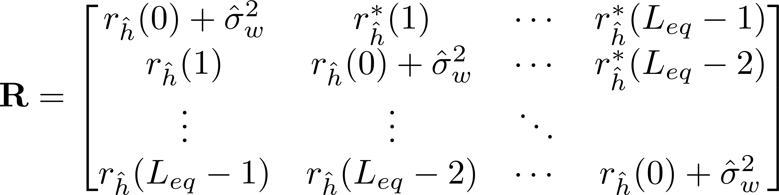
ZF & MMSE Equations
ZF
MMSE

Slide 43
ZF & MMSE Equations
ZF
MMSE

Slide 44


Computing ZF & MMSE
Solve: Levinson-Durbin recursion algorithm to solve by leveraging the toeplitz property of
Inverse: cuBLAS LU decomposition library to compute the inverse and matrix vector multiplication defined by
Solve: using the cuSolverSp library to solve by leveraging the sparse property of

Slide 45
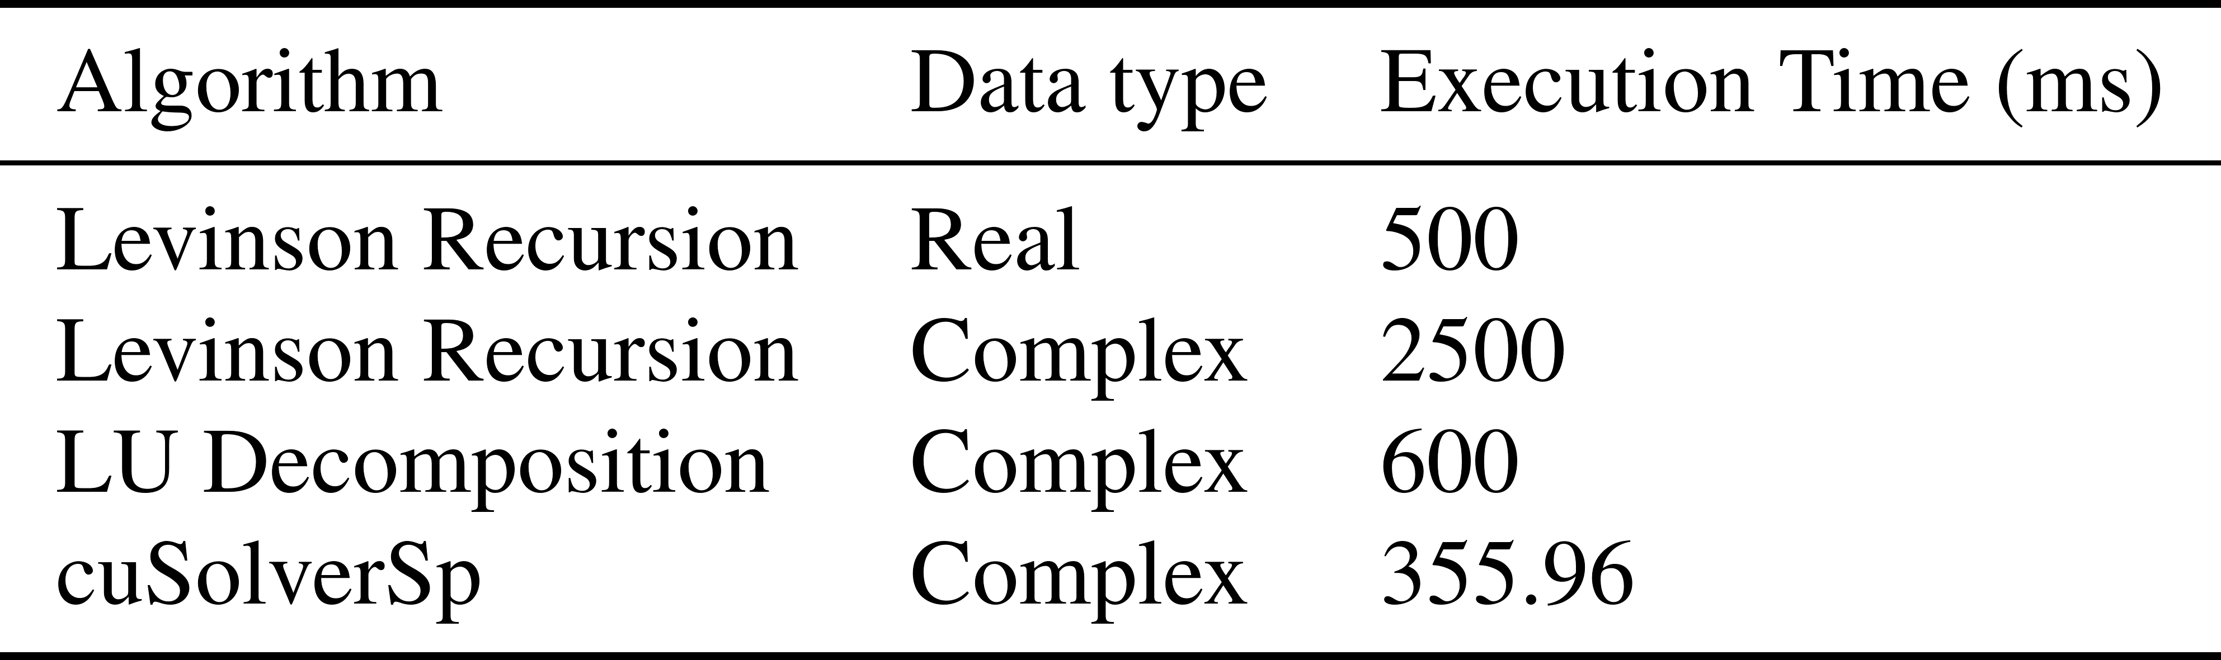
Computing ZF & MMSE

Slide 46



Computing & Applying ZF Using cuSolverSp
Fill Vector
cuSolverSp
Frequency-domain Convolution
Fill CRS
Matrix
Auto-
Correlation

Slide 47

Computing & Applying MMSE Using cuSolverSp
Fill Vector
cuSolverSp
Frequency-domain Convolution
Fill CRS
Matrix
Auto-
Correlation

Slide 48
Constant Modulus Algorithm
(CMA) Equalizer

Slide 49
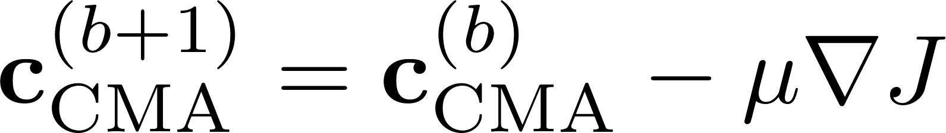

CMA Equations

Slide 50
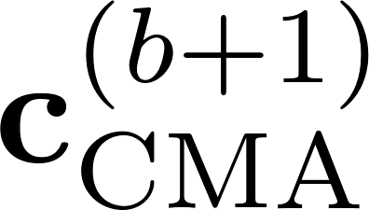
Computing & Applying CMA Using Convolution
Frequency-domain Convolution
Frequency-domain Convolution
Update
CMA
Filter

Slide 51

Computing CMA
Computing is the bottleneck in the CMA equalizer update
can be computed by:
Implementing directly
Reformulating to leverage GPU convolution

Slide 52
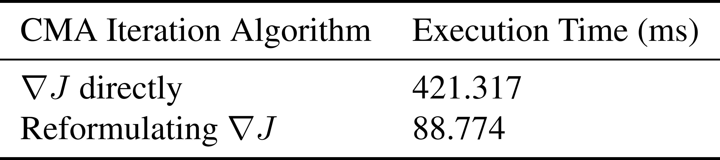
Computing CMA

Slide 53
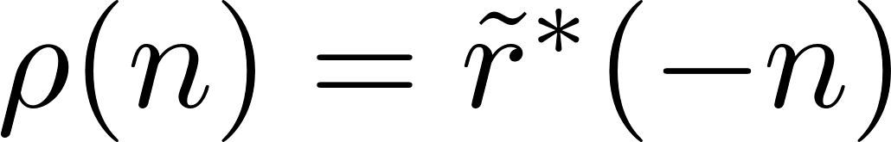
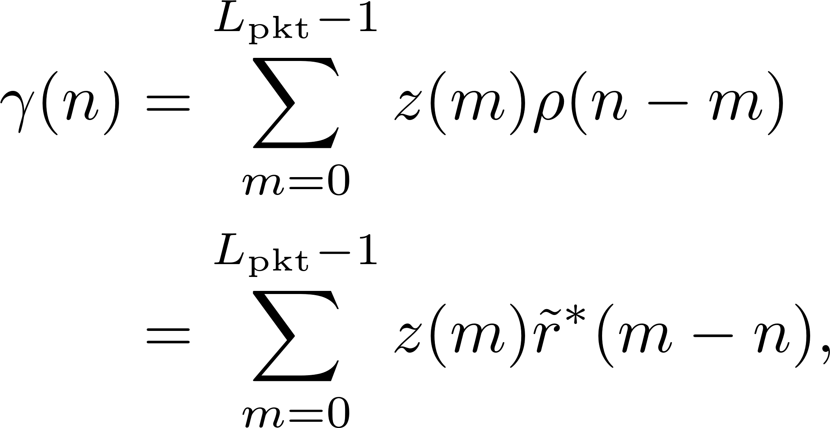
Reformulating CMA Equations

Slide 54
Reformulating CMA Equations

Slide 55
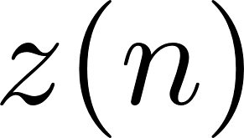

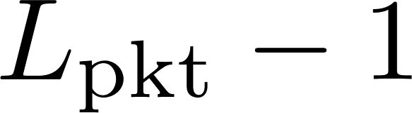

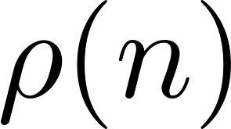
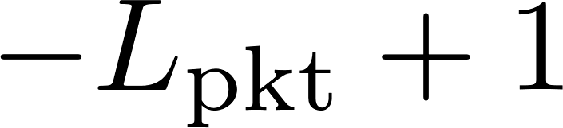
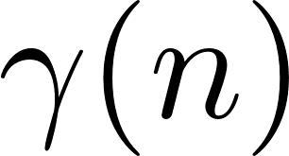
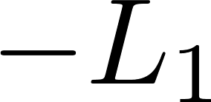
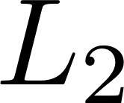
Reformulating CMA Equations

Slide 56
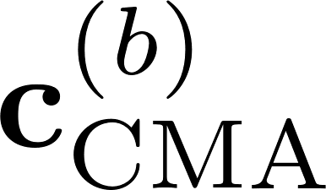



Computing & Applying CMA Using Convolution
Frequency-domain Convolution
Multiply
Frequency-domain Convolution
Steepest Descent
Conjugate Time Reversal
Frequency-domain Convolution

Slide 57
Frequency Domain Equalizer
One and Two
(FDE1 & FDE2) Equalizers

Slide 58
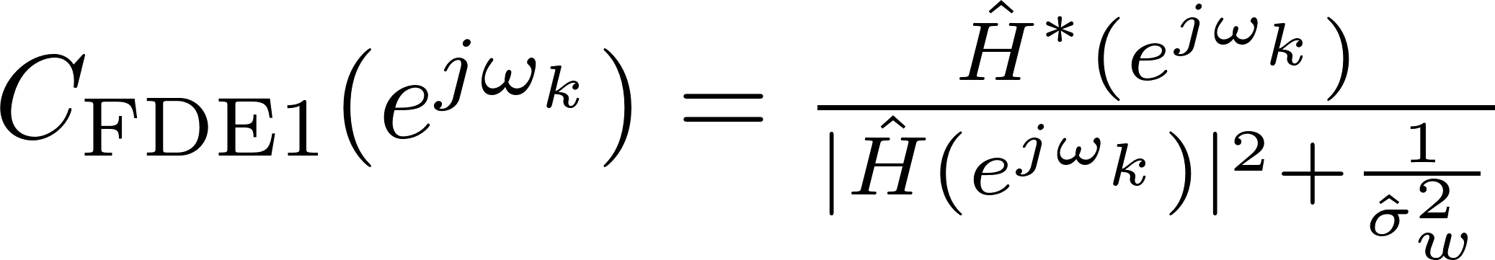
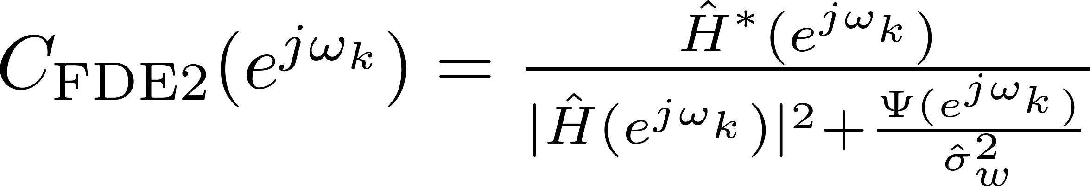
Computing & Applying FDE1 & FDE2

Slide 59
Computing & Applying FDE1 & FDE2

Slide 60
Computing & Applying FDE1 & FDE2
PSD of
SOQPSK-TG

Slide 61
Computing & Applying - PSD of SOQPSK-TG

Slide 62
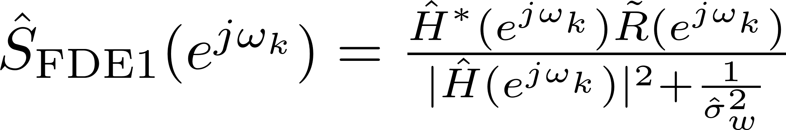
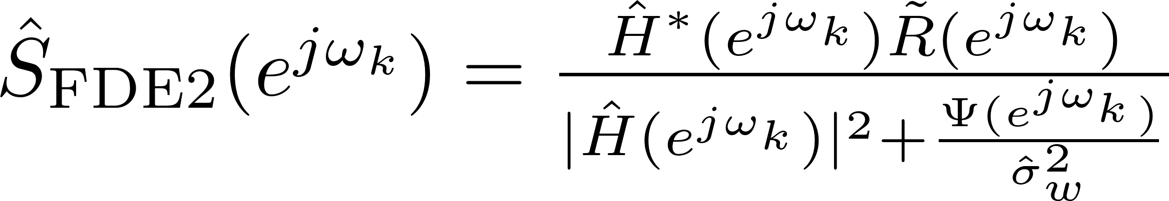
Computing & Applying FDE1 & FDE2

Slide 63
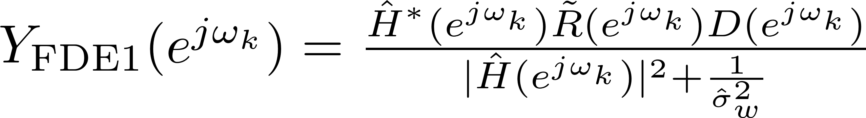
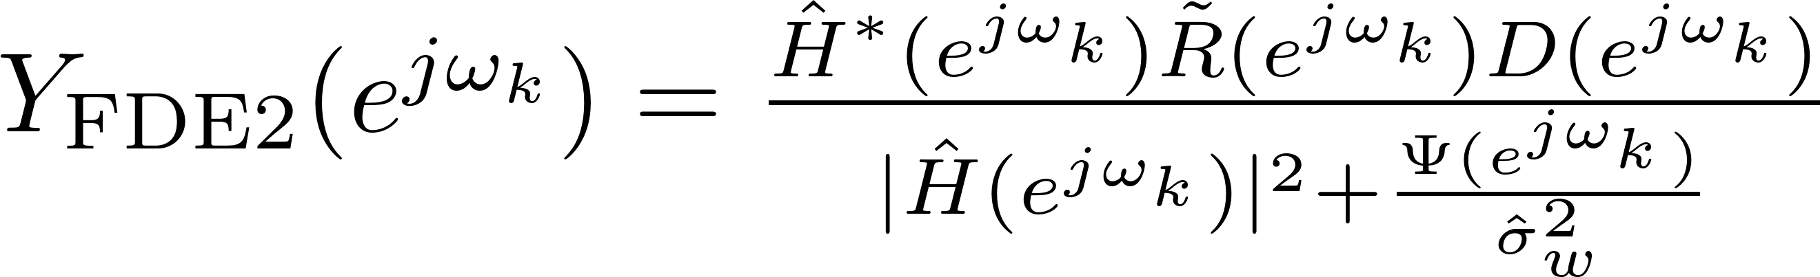
Computing & Applying FDE1 & FDE2

Slide 64
Computing & Applying FDE1 & FDE2

Slide 65
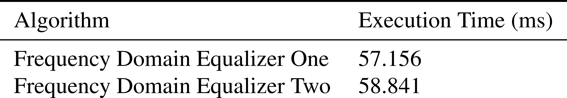
Computing & Applying FDE1 & FDE2

Slide 66
Computing & Applying FDE1
FFT
Point-to-point
Multiplication & Division
IFFT
FFT

Slide 67
Computing & Applying FDE2
FFT
Point-to-point
Multiplication & Division
IFFT
FFT

Slide 68
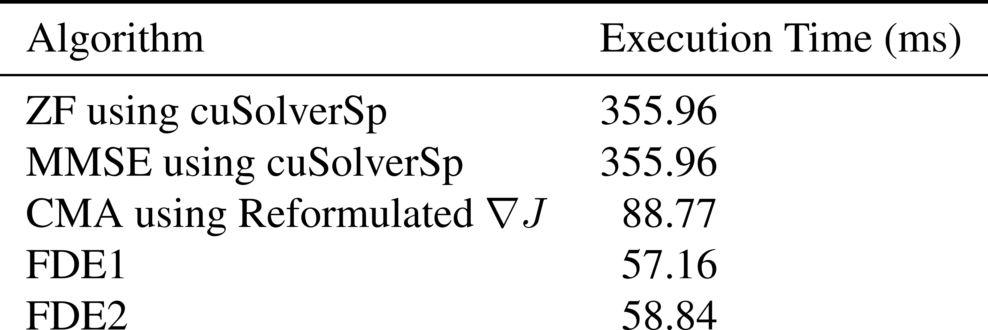
Equalizer Execution Time Comparison

Slide 69
Equalizer Execution Time Comparison

Slide 70
Static Multipath Testing
and Performance Comparison

Slide 71
Static Multipath Test Setup
SOQPSK-TG TX
Multipath
Channel
Host CPU
FPGA
Distorted RF
Noise
Source
Bits & Clk
Power Splitter
T/M Receiver
Preamble Scrubber
BERT
Bits & Clk
Bits & Clk
ADC
Host CPU
Host CPU
FPGA
FPGA
Samples
70 MHz IF
Spectrum
Analyzer
K40c GPU
K20c GPU
K20c GPU
Rack Mounted Server

Slide 72
Static Multipath Test Setup
SOQPSK-TG TX
Multipath
Channel
Host CPU
FPGA
Distorted RF
Noise
Source
No T/M Receiver with
blind equalizer was available
Bits & Clk
Power Splitter
T/M Receiver
Preamble Scrubber
BERT
Bits & Clk
Bits & Clk
ADC
Host CPU
Host CPU
FPGA
FPGA
Samples
70 MHz IF
Spectrum
Analyzer
K40c GPU
K20c GPU
K20c GPU
Rack Mounted Server

Slide 73
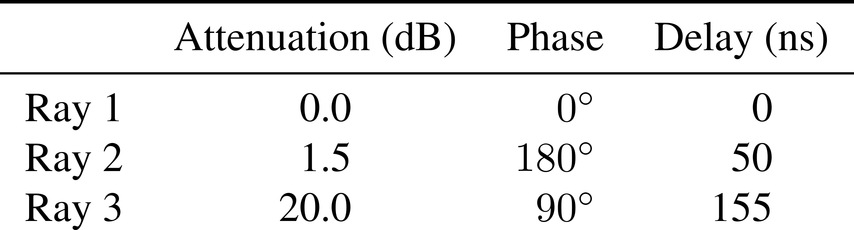
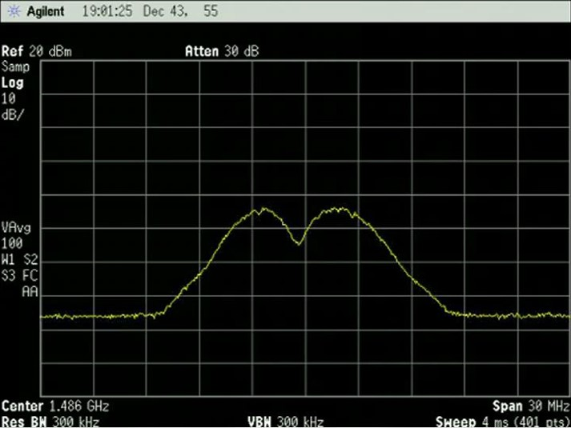
Channel 1

Slide 74

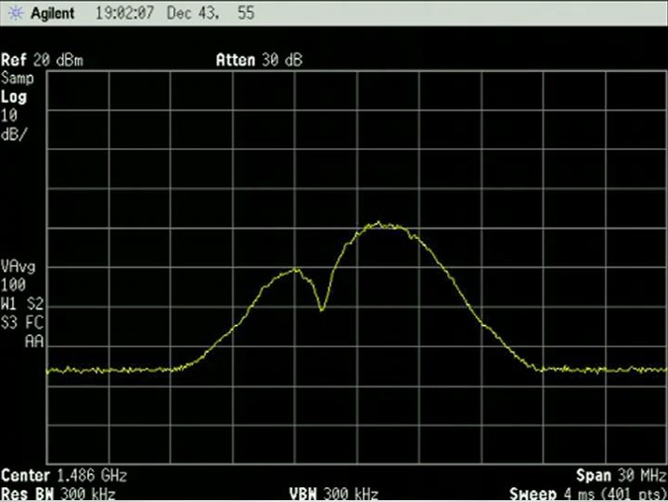
Channel 2

Slide 75

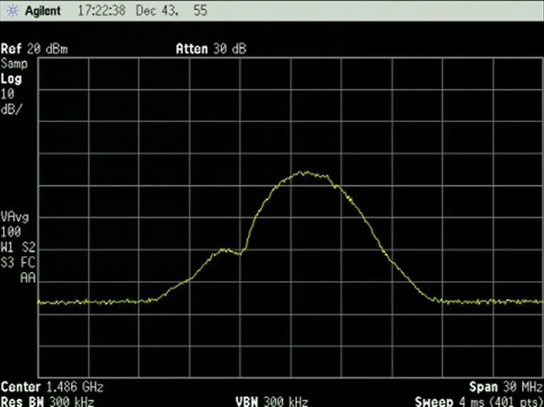
Channel 3

Slide 76
Conclusions
All equalizers have a 2-3 dB spread
ZF, MMSE and FDE1 consistently perform well
CMA and FDE2 perform either the best or worst depending on the channel
FDE1 is recommended, marking the best tradeoff between performance and computational complexity

Slide 77
Future Work
Investigate GPU implementation of a maximum likelihood sequence estimator (MSLE) for SOQPSK-TG
Investigate using a Levinson-Durbin algorithm that leverages both the Toeplitz and sparse properties of and the sparseness of for the ZF and MMSE equalizer
Process data from flights at Edwards AFB in April 2017

Slide 78
Questions?

Slide 79






Convolution - Single Convolution
Time domain
Frequency domain

Slide 80

Convolution - Single Convolution Block Diagram
Time domain
Frequency domain
FFT
Time-domain Convolution
Complex
Multiplication
IFFT
Scalar Multiplication
Time-domain Convolution
FFT

Slide 81

Batch Convolution - Flops vs. GPU Execution Time
tap detection filter

Slide 82

Batch Convolution - Flops vs. GPU Execution Time
tap equalizer filter

Slide 83
Introduction - PAQ Signal Processing
186 Taps
23 Taps
Preamble
Detector
Equalize
Detection
Filter
2
Frequency
Offset
Estimator
PLL
Estimators
1.907 Seconds is 3103 or 3104 iNET Packets

Slide 84

Convolution - Cascaded Convolution
Time domain
Frequency domain

Slide 85
Convolution - Cascaded Convolution Block Diagram
Time domain
Frequency domain
FFT
Time-domain Convolution
FFT
Complex
Multiplication
IFFT
Scalar Multiplication
Time-domain Convolution
FFT

Slide 86

Batch Convolution - Flops vs. GPU Execution Time
tap detection filter

